Slide 1







Financial & Retirement
Goal base financial projections, Retirement Income distribution strategies, Cash Flow Analysis and strategy
Insurance Planning
Life, disability, long term care, Risk Assessment and Mitigation Strategies
Our Clients
Personal CFO
Financial Oversight
Strategic Planning
Trusted Advisor
Medicare Planning
Medicare enrollment guidance, Supplemental & Advantage plan selection, Cost reduction & coverage optimization
Taxes
Tax Preparation, Year-Round Tax Planning, Tax Mitigation
Estate Planning
Will & Trust creation, beneficiary reviews & asset protection, Wealth transfer & charitable giving strategies
Asset Management
Tailored investment strategies, Portfolio Diversification & risk analysis, Active monitoring & market adjustments.

Slide 2


Fiduciary Comprehensive Financial Planning
Financial Position Planning
Risk Protection Planning
Investment Strategy Planning
• Net Worth Analysis
• Cash Reserve Strategies
• Cash Flow Management
• Debt Analysis & Management
• Discretionary Income Management
• Expected Large inflows/outflows
• Lines of Credit
• Disability – Long Term Care – Life
• Medical / Medicare
• Employer Benefits
• Property Casualty / Umbrella Liability
• Current Policy Reviews
• Beneficiary Designations
• Special Needs Situations
• Asset Allocation
• Options/Restricted Stock/ non-qualified deferred compensation
• Risk Tolerance alignment
• Tax Smart and Tax Efficient Investing
• Diversification Strategies
• Tax Implications
Tax Strategy and Planning
Retirement Planning
Estate Planning
• Tax – Deferral, Reduction, Mitigation
• Tax Projections
• Future Taxes Due
• Effects of Liquidation
• Withholdings
• Filing Status
• Business Ownership
• Investment Real Estate Planning
• Tax Preparation
• Minimum Distributions
• Pre-59 ½ Strategies
• Required Minimum Distribution Strategies
• IRA’S, Roth IRA’s, 401k’s, 403b’s
• Roth Conversion Strategies
• Income streams – transitions
• Social Security Strategies
• Medicare/Medigap
• Risk Tolerance Transition
• Timing Issues
• Trusts, Wills, Power of Attorney’s
• Asset Ownership
• Estate Balancing
• Trust Funding
• Succession Planning
• Special Needs Planning
• Charitable Giving
• Estate Liquidity

Slide 3

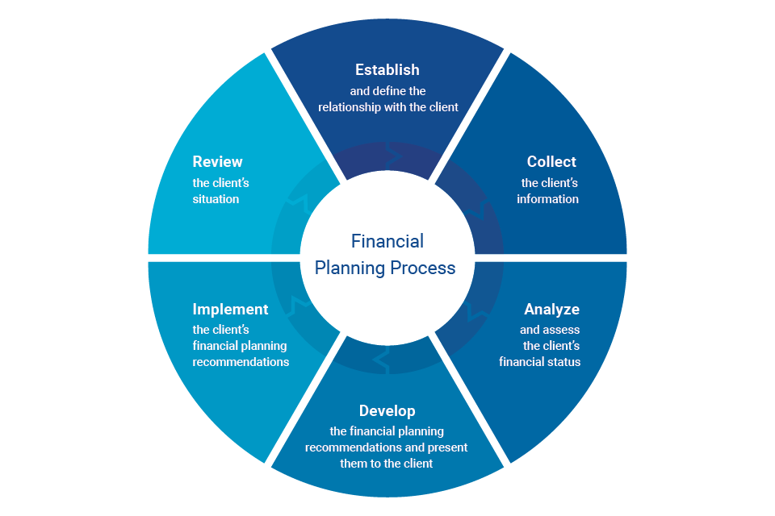
Comprehensive Planning
Cash Flow & Withdrawal Strategies
Retirement Analysis
Tax Planning
& Tax Optimization
YOUR
PLAN
Investment Management & Tailored Portfolios
Review & Monitor
Estate Planning & Trust Review

