Slide 1


The Three Concerns Keeping $25M+ Families Up at Night
Macro-Economic Factors, Security & Legacy, Lifestyle & Values – Actionable Insights for Advisors
John Bowen, CEO of CEG Worldwide & CEG Insights

Slide 2



What Drives Ultra-Wealthy Clients?
Ultra-wealthy clients are more than just high-net-worth investors; they are entrepreneurs, high-level professionals, and inheritors who require advisors who deeply understand their values, aspirations, and challenges.
The Three Core Dimensions of Ultra-Wealthy Client Concerns
Security & Legacy
2
Wealth protection, asset security, estate considerations, and multi-generational wealth transfer.
Macroeconomic Factors
Inflation, national debt, market volatility, and risk mitigation.
1
Lifestyle & Values
3
Family governance, philanthropy, and aligning wealth with long-term purpose.
Serving ultra-wealthy clients requires more than investment expertise—it demands an integrated approach that aligns financial planning with their broader life goals.

Slide 3
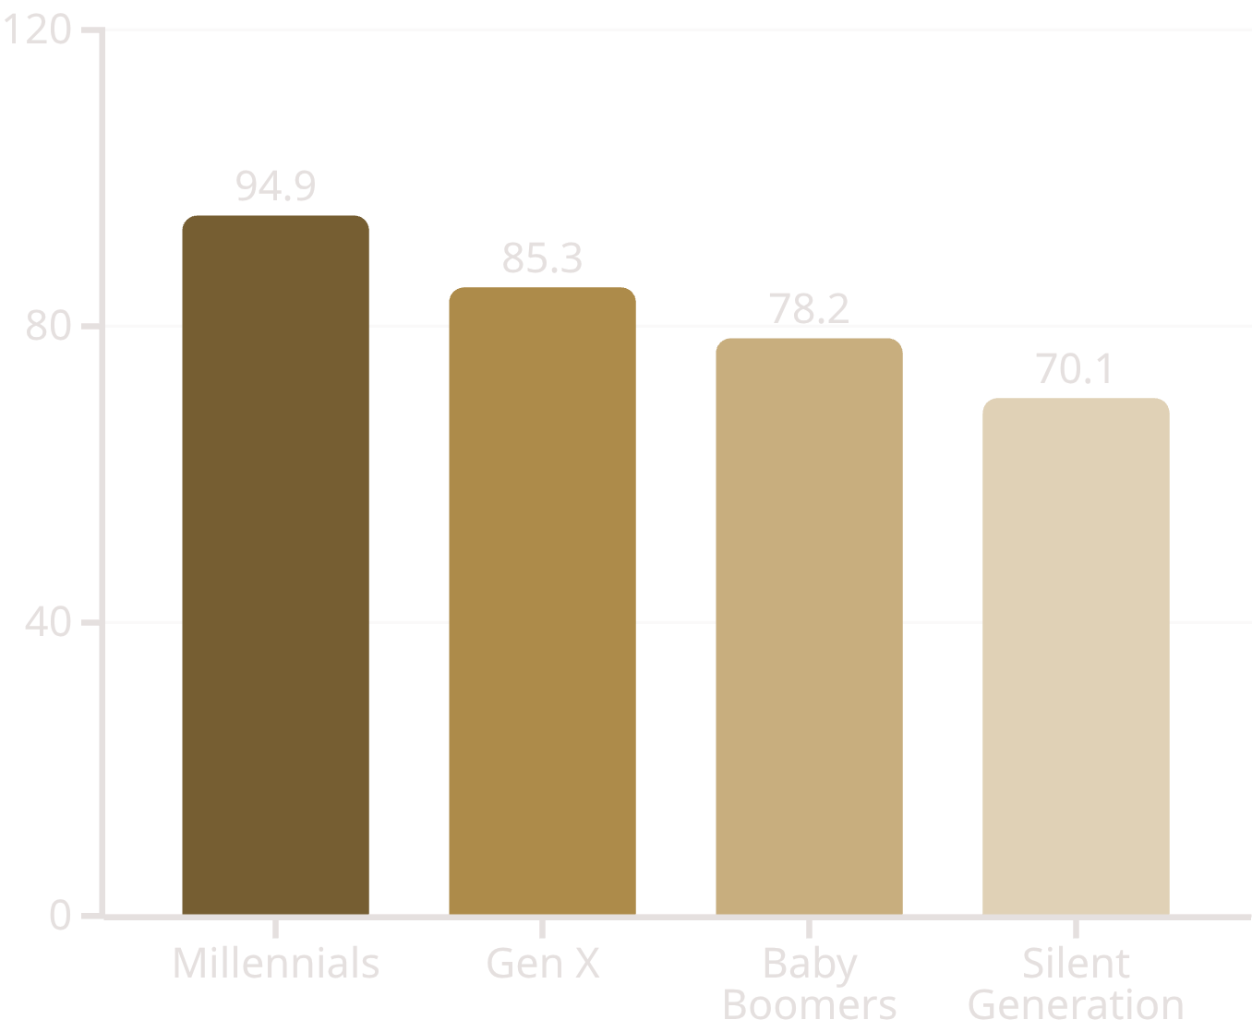
Concern 1 – Macro-Economic Factors
Top Worries
Inflation, volatility, geopolitical risks (82.1% of ultra-HNW demand active involvement).
Advisor Shift
From mean-variance to sovereign risk frameworks; integrate AI for predictive analytics.
Opportunity
Proactive strategies build reassurance, scaling to HNW clients amid market shifts.
Concern by Age Group (% Hands-on)
"Traditional tools fall short; contextualize global events to become indispensable."

Slide 4

Concern 2 – Security & Legacy
Client Concerns & Opportunities
Advisor Strategies & Tools
Trust Structures
1
Core Fears
1
Establish appropriate vehicles
Asset protection and multi-generational transfer (77.5% worry about wasteful heirs).
Family Governance
2
Create decision frameworks
2
Solutions
Blend estate structures with family governance coaching and heir education.
Heir Education
3
Prepare next generation
3
Payoff
Fosters loyalty (75.1% encourage heirs to use same advisors); opens multi-gen relationships.
"Elevate from manager to steward—address emotional trade-offs AI can't handle."

Slide 5




Concern 3 – Lifestyle & Values
Aligning Values with Planning Process
Priorities
Advisor Role
Philanthropy, purpose, impact (85.8% value leaving a legacy; 80.3% want coordinated pros).
Align wealth with values via Investment management, mitigating taxes, taking care of the heirs, protecting assets from unjustly taken, charitable strategies, and lifestyle services.
Differentiation
Captures AI-resistant share; resonates post-liquidity events for founders.
"Go beyond returns—help clients build amazing lives of significance for deeper connections."

Slide 6
Actionable Steps & Next Actions
30 Days: Deep Discovery
90 Days: Measure Impact
Conduct comprehensive client interviews to uncover concerns
Evaluate results and refine approach based on client feedback
1
2
3
60 Days: Integrate Solutions
Develop and implement tailored strategies addressing all three concerns
For Any Advisor:
Reframe conversations to uncover concerns
Build networks for holistic delivery
"Turn insights into results—book a consultation to map these concerns to your practice growth."

Slide 7
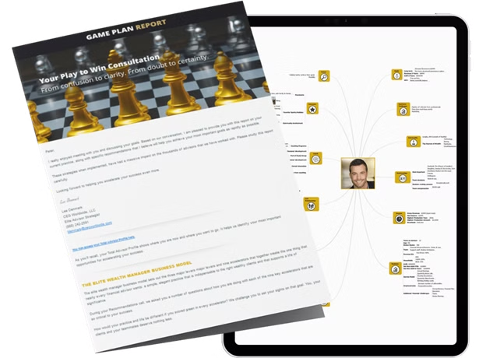
What You'll Get in Your Play-to-Win Consultation
If you're a financial advisor looking to grow faster while working smarter, this consultation will provide a clear, customized roadmap to achieving your biggest goals.
Step 1: The Total Advisor Profile—A Roadmap to Your Next Level
During your first session, we conduct a deep dive into your business to create your Total Advisor Profile—a personalized blueprint outlining:
Where you are today in your practice.
Your biggest opportunities to scale.
The fastest way to elevate your success.
Step 2: Your Private Strategy Consultation—Backed by Research & Real-World Results
During your one-on-one strategy call, you'll meet with a senior CEG Worldwide coach who will provide:
Exclusive, data-driven insights from thousands of high-net-worth clients—so you know exactly what they want from their financial advisors today.
Proven strategies from our work coaching top-performing financial advisors—real tactics that actually work.
A clear, customized action plan tailored to your specific goals—whether that's doubling your AUM, attracting ultra-high-net-worth clients, or building a streamlined, high-impact wealth management practice.
Step 3: Exclusive Access to CEG Worldwide's Elite Network
Join the industry's leading coaching firm, trusted by top financial advisors to:
Scale efficiently
www.cegwin.com/ultra-kitces
Build high-value client relationships
Achieve sustainable, long-term success
The top advisors have used this exact system to grow their practices—now, it's your turn.

