Slide 1
Financial Education Workshop
Presented by:
Duncan Financial Group
Private Wealth Management

Slide 2
Intro
Financial Planning Workshop – purpose is to cover fundamentals of common financial planning considerations
Important Note: no personal recommendations or advice can be provided this evening due to compliance guidelines. This is intended for informational purposes only and should not be used as the primary basis for an investment decision. Consult an advisor for your personal situation.
Brian
President of Duncan Financial Group
Graduate of University of Pittsburgh (B.A.) and Duquesne University (M.B.A) with a degree in Finance
Licensed in Life & Health Insurance and holds a series 6, 7 & 66 and is a CFP® Professional
15 Years Industry Experience
Kristen
Strategic Planning Analyst at Duncan Financial Group
Graduate of Seton Hill University (B.A. and M.B.A.) with a degree in Business Administration
Licensed in Life & Health Insurance and holds a series 6, 7 & 66 and has her CRPC® designation
18 Years Industry Experience

Slide 3
Agenda
Common Investing Pitfalls
Importance of Retirement Planning
Key Takeaways
Q&A

Slide 4
Common Investing Pitfalls

Slide 5
The Market Has Shown Resilience
Sources: American Funds

Slide 6
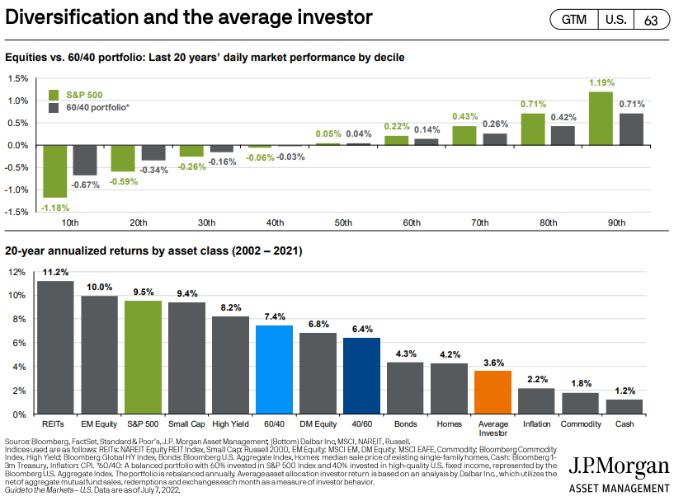
Diversification and Avoiding Emotional Investing:

Slide 7
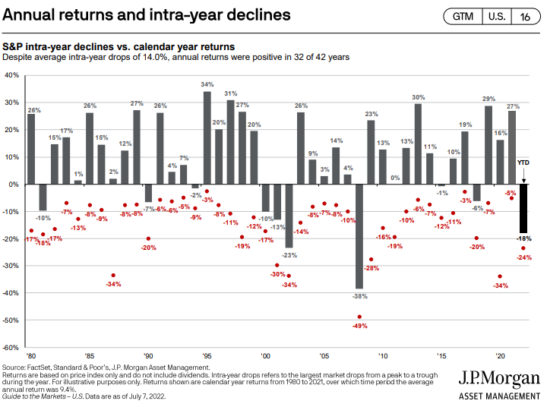
Staying the Course in Challenging Times
Despite many years having drops at some point during the calendar year, since 1980 there have been 32 positive years out of the past 42.

Slide 8
Planning Fundamentals
Getting Your Ducks in a Row

Slide 9
Goal Setting – What Is Important To You?
Money to live life now and also money to live ON later
Retirement can be expensive
Sources of retirement income²
33%
70%
Social Security
67%
is roughly the amount of your annual pre-retirement income that many experts estimate you’ll need each year of retirement.¹
All other sources:
Company retirement plan
Pensions
Personal savings and investments
Earnings/income
Other
¹Center for Retirement Research at Boston College, Social Security And Total Replacement Rates In Disability And Retirement, http://bit.ly/income-replace, May 2018.
²Social Security Administration, Fast Facts & Figures about Social Security, 2018.

Slide 10
Considerations & Ways to Save
Time Horizon: Short-, Mid- and Long-Term savings
Each has a purpose and therefore is treated differently
Risk Tolerance – Risk vs. Reward

Slide 11
Tax Treatment of Investing: 3 Tax Buckets

Slide 12
Estate Planning: How your assets transfer

Slide 13
Retirement Planning

Slide 14
Retirement Planning Concerns
Inflation
Longevity
Taxes
Rising Healthcare Costs

Slide 15
Why is a Plan Important
A formal, written retirement plan vastly enhances people’s confidence in being able to retire well
Half of people ages 55 to 75 who have a formal retirement plan feel very prepared for retirement, compared to only 17 percent of those who do not have a plan.
*FA Mag, Formal Retirement Plan Boosts Confidence, https://www.fa-mag.com/news/formal-retirement-plan-boosts-confidence-24971.html, accessed February 2016

Slide 16
Retirement Planning Can Address These Concerns
Comprehensive Planning Considerations
Potential risk associated with outliving assets and retirement income gaps
Identification of projected retirement surplus or shortfall
Testing against future market conditions
Coordination of Qualified and Non-Qualified sets for optimal income formulation
Social Security Optimization and Retirement Income Planning
Risk Management
Estate Planning
Tax Planning
Coordination with CPA, Estate Attorney and Other Professional Advisors

Slide 17
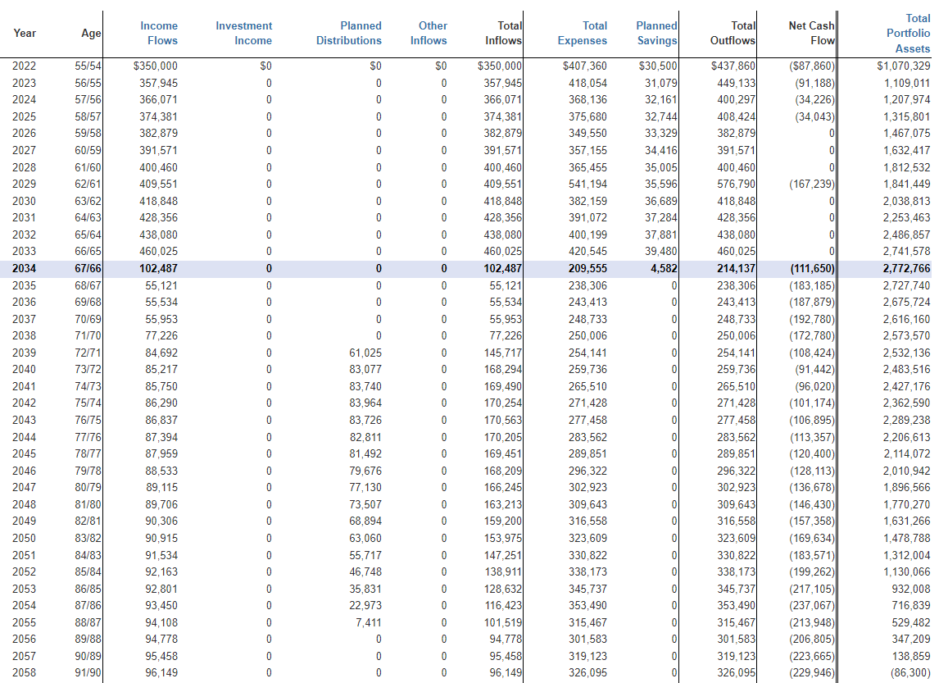
Growing Your Wealth
Growing Your Wealth is more than just saving money for the future. A cash flow analysis can help with the following:
Future income generation from savings
Identifies income sources and future outflows
Potential risk associated with outliving assets and retirement income gaps
Identification of projected retirement surplus or shortfall
Coordination of Qualified and Non-Qualified assets for optimal income formulation
Social Security Optimization and Retirement Income Planning

Slide 18
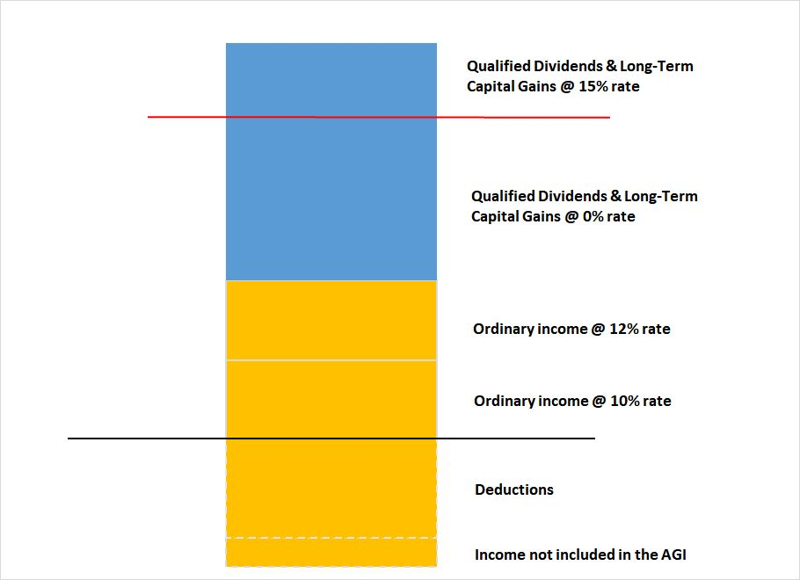
Optimizing Income
$89,250 for Married Couple
Highlights how to time income with RMD’s and using NQ accounts to stay at 0% tax on qualified dividends and capital gains, for discussion

Slide 19
Leveraging Your Wealth
Leveraging Your Wealth is important both during years of accumulation and distribution. An analysis of your risk versus rewards can help with the following:
Portfolio construction and evaluation integrated with tax and estate needs
Confirming you're adequality being compensated for the amount of risk in your portfolio
Understanding if you're taking too much risk - or not enough risk - given your short and long term financial goals
Investment Strategy should be at least in part based on your future income needs, not just a 70/30 hope and prayer!

Slide 20
Protecting Your Wealth
Protecting Your Wealth answers the question: If something unforeseen happened to me today, would my family have adequate resources to maintain their current standard of living and meet their future goals?” An insurance analysis can help with the following:
Confirms you have sufficient life insurance in the event of a premature death
Confirms you have sufficient disability insurance in the event you were forced to quit working
Confirms you have sufficient assets to cover a long term care event
Confirms you have sufficient property and casualty Insurance to cover your net worth

Slide 21
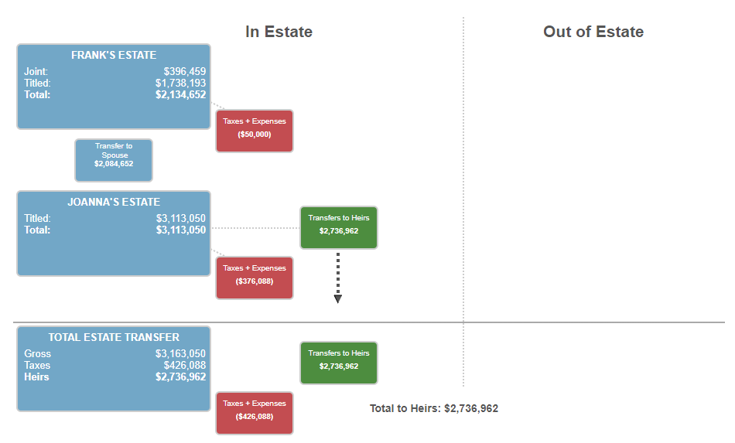
Transferring Your Wealth
Transferring Your Wealth ensures your legal documents, ownership structure and beneficiary designations are aligned to your estate planning goals. An estate analysis can confirm the following:
Your Wealth Transfer and Legacy Goals are aligned to your asset structure
Heirship and Liquidity Solutions have been identified

Slide 22
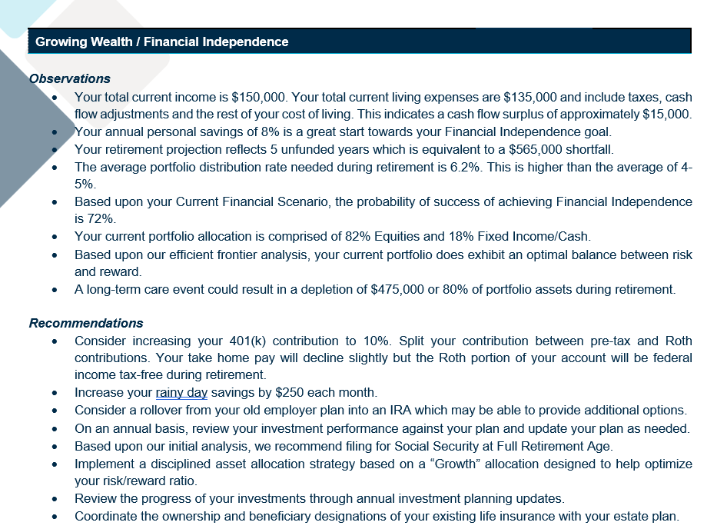
Why is a Plan Important

Slide 23
Takeaways
REMEMBER It’s never too EARLY to plan, But it can become too LATE to make a difference.
A PLAN should be reviewed at least annually.
A COMPREHENSIVE view of your Financial Picture leads to better decision making

Slide 24
Thank you for your time and the opportunity to help! Any Questions?
Brian Duncan, CFP®
President / Investment Advisor Representative
Private Wealth Management
P: 724-863-3287 x3102
E: brian.duncan@cambridgesecure.com
Kristen Hull, CRPC®
Strategic Planning Analyst
Private Wealth Management
P: 724-863-3287 x3126
E: kristen.hull@cambridgesecure.com
DuncanGRP.com

